Slide 1
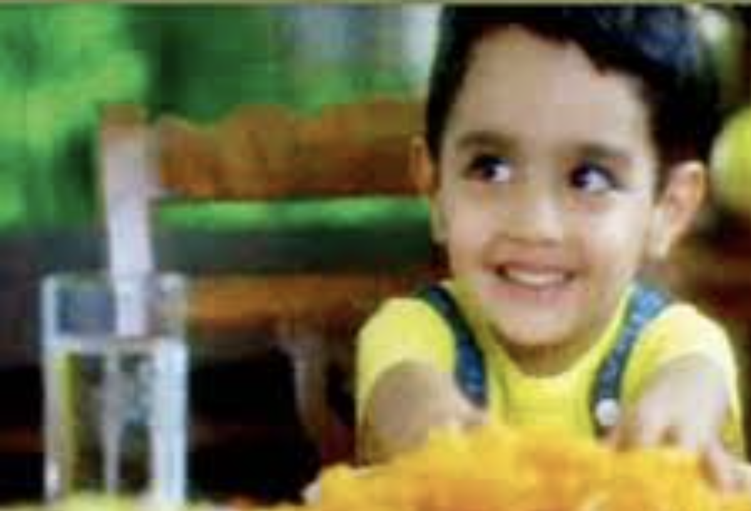
We all learnt a new (squeaky) way of saying “Jalebee” after watching this one! Which cooking oil is the ad about?
Notes:
dhara

Slide 2
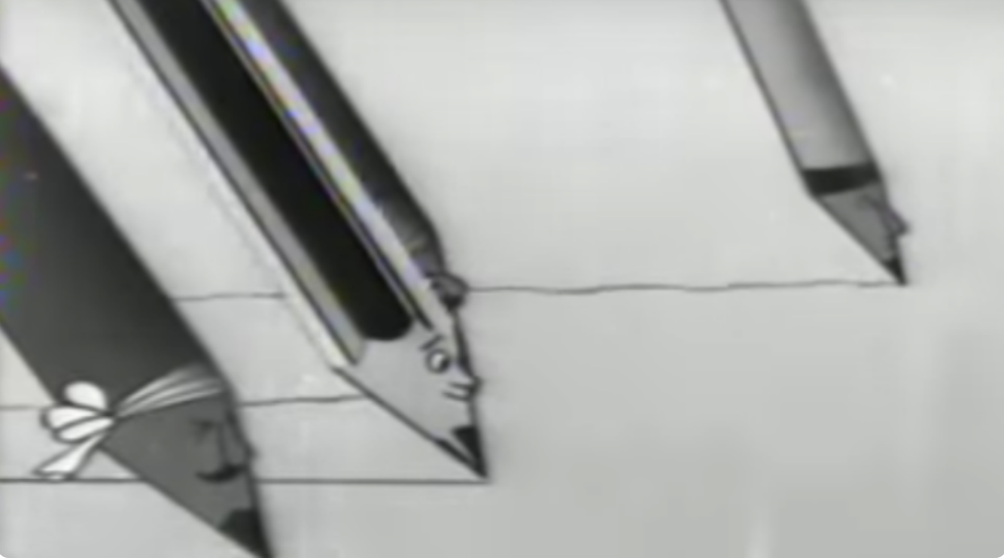
WHICH PENCIL BRAND USED THIS RACE ANIMATION TO PROMOTE IT
Notes:
natraj

Slide 3
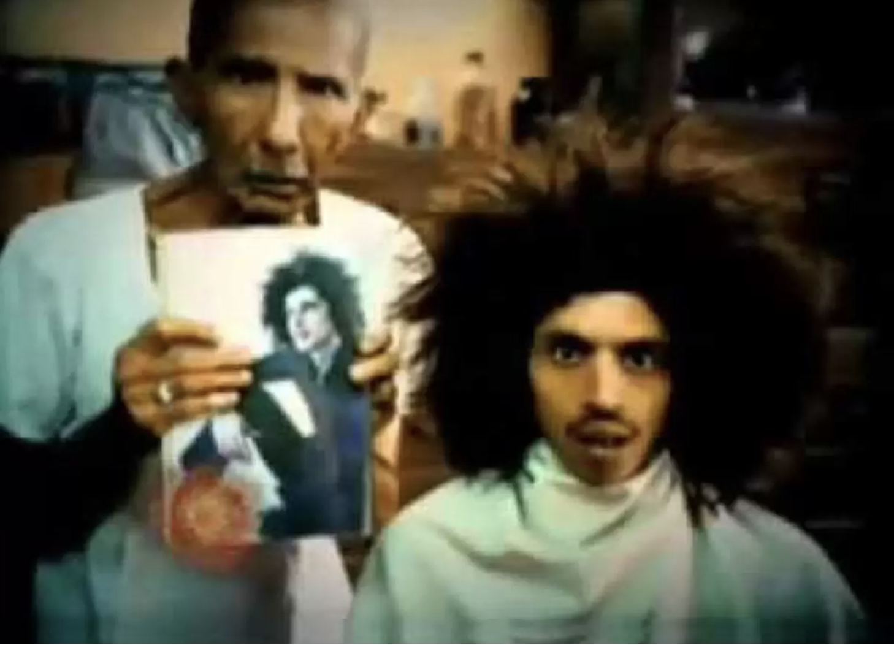
Rotomac
Notes:
Centre shock

Slide 4
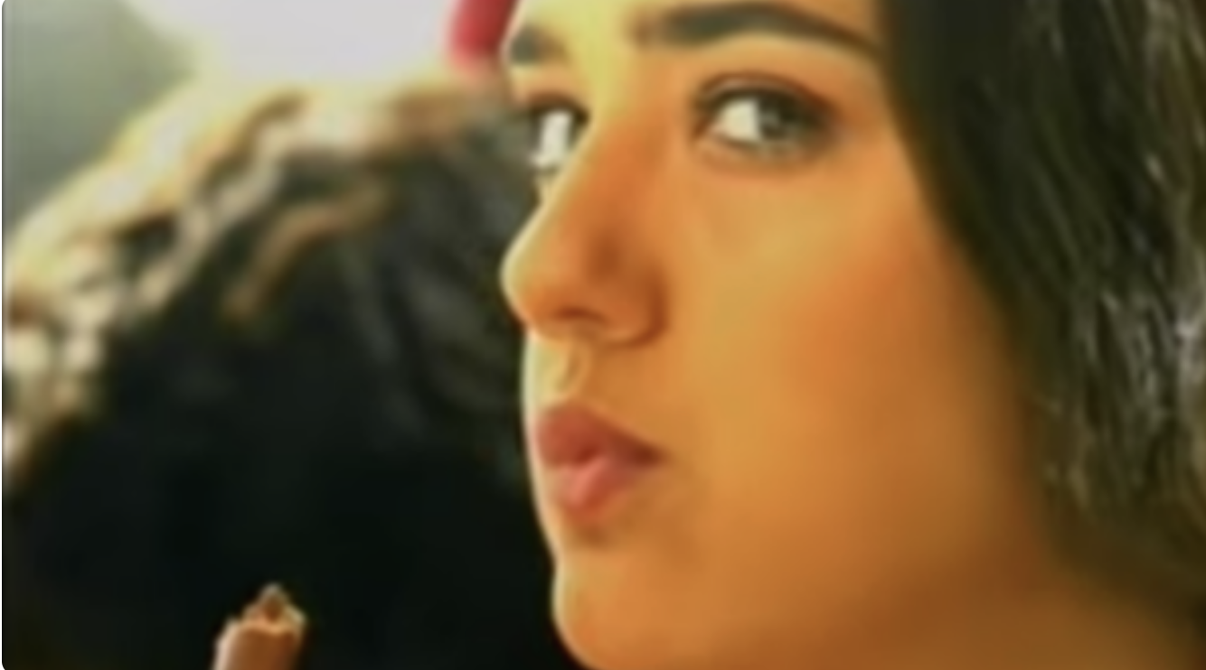
Preity Zinta became popular with this chocolate commercial
Notes:
perk

Slide 5
IDENTIFY THE BRAND USING THE FAMOUS TAGLINE
“The Complete Man”
Notes:
raymond

Slide 6
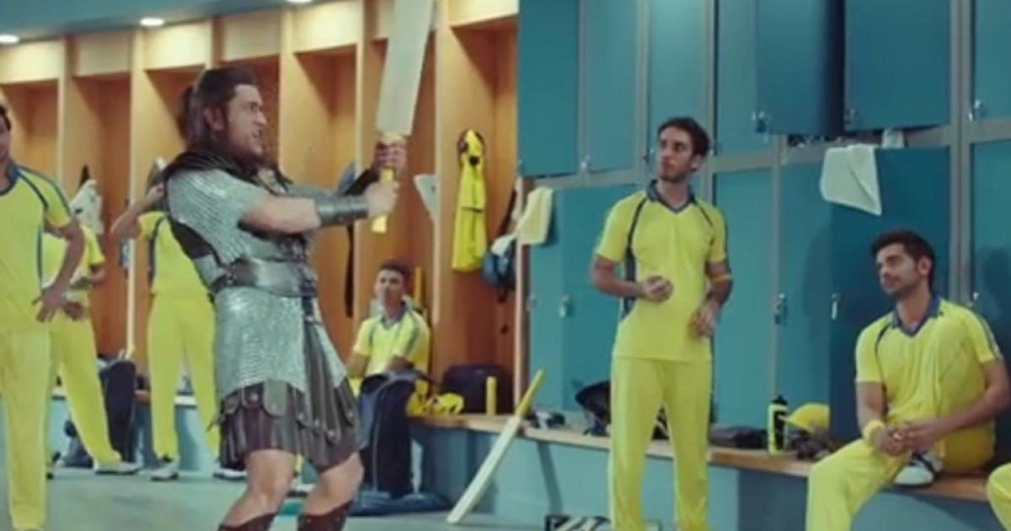
Dhoni showed us his angry side for this Ad
Notes:
snickers

Slide 7
IDENTIFY THE BRAND USING THE FAMOUS AD JINGLE
“ ICE ICE BABY ”
Notes:
whirlpool

Slide 8
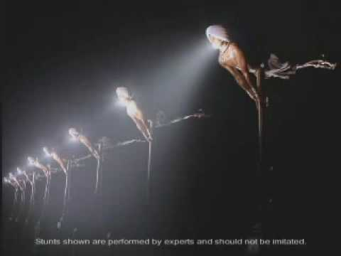
This unconventional ad made us all laugh
Notes:
happydent

Slide 9
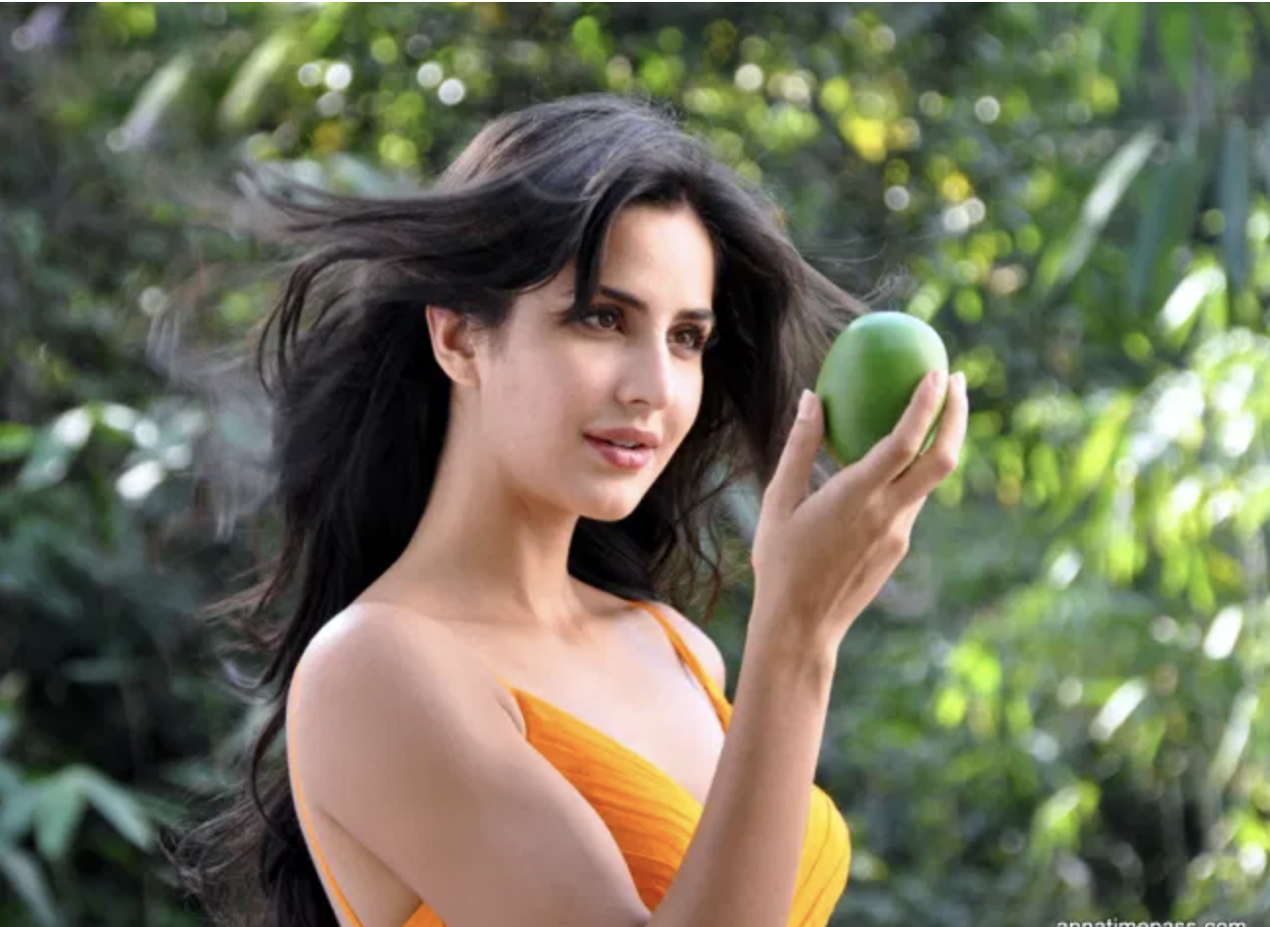
Which fruit drink is Katrina Kaif romancing this mango for?
Notes:
Slice

Slide 10
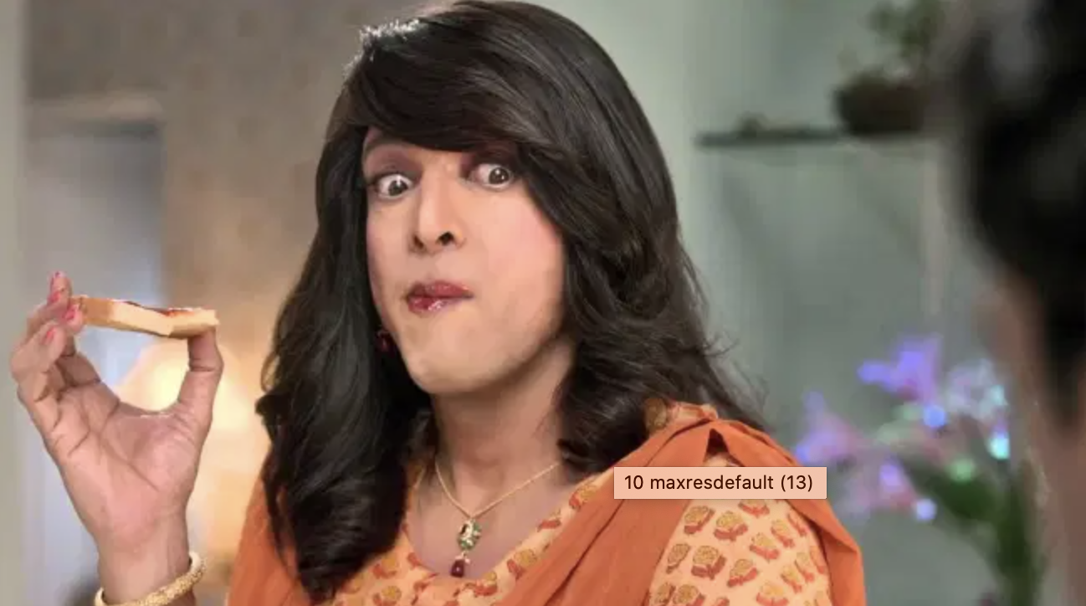
What does (aunty) Javed Jaffery has smeared on his toast here?
Notes:
Maggi tomato ketchup

